Slide 1
2. Decision Tree (R)

Slide 2
2. Decision Tree

Slide 3
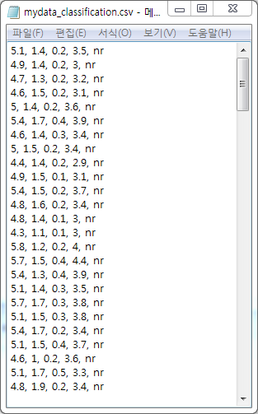
2.1 Data preparation and set up
①
Let "C:/Rtest＂ have "mydata_classification.csv" → using memo or excel, prepare data with name.csv로
Set up Rtest as default directory
②
> setwd("c:/Rtest")
Install party which has decision tree algorithm
> install.packages("party")
> library(party)
③

Slide 4
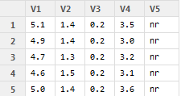
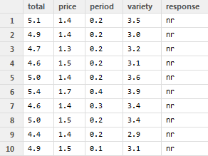
Read data
> result <- read.csv("mydata_classification.csv", header=FALSE)
> View(result)
> install.packages("reshape")
> library(reshape)
> result <- rename(result, c(V1="total", V2="price", V3="period", V4="variety", V5="response"))
> View(result)
①
②
③
With mydata_classfication.csv, read
Data and save it into result
Install reshape
Make each column unstandable with names
total, price, period, variety, response

Slide 5
2.2 Decision tree algorithm
> set.seed(1234)
> resultsplit <- sample(2, nrow(result), replace=TRUE, prob=c(0.7, 0.3))
> trainD <- result[resultsplit==1,]
> testD <- result[resultsplit==2,]
> rawD <- response ~ total + price + period+ variety
> trainModel <- ctree(rawD, data=trainD)
①
②
③
Generate random number when sampling
Divide the data into two by the ratio of 7:3 n
trainD(training data)
testD(test data)
Specify nr(no response), low(one) high(many) total price, period variety in response of result의
Specify model to use

Slide 6

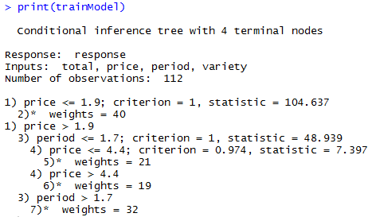
2.3 Analysis
> table(predict(trainModel), trainD$response)
> print(trainModel)
①
Classify values in response using trainModel
Test data: 112
Price Period are important classification variables

Slide 7
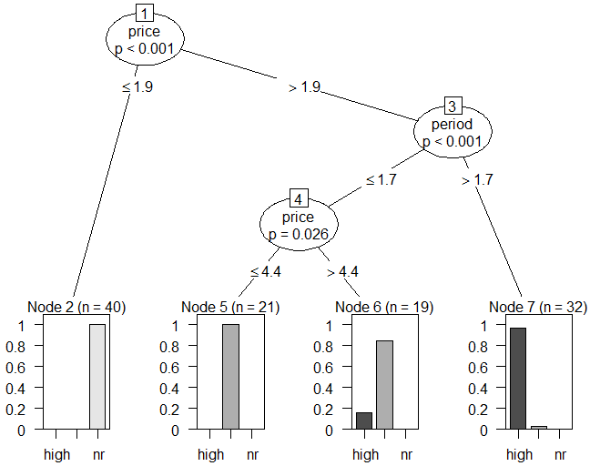
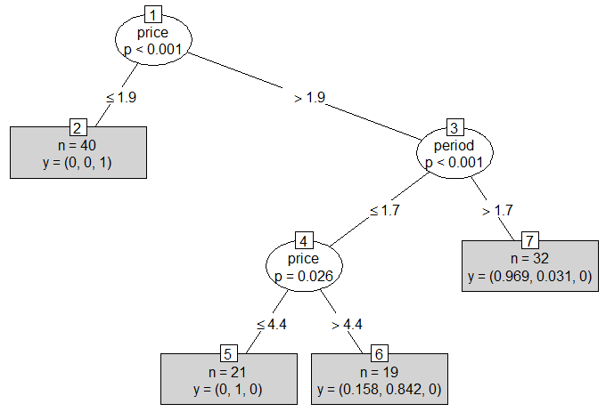
2.4 visualization of decision tree
> plot(trainModel)
> plot(trainModel, type="simple")
①
②
Show in tree form
Show tree in simplified form

Slide 8

2.5 Test model
> testModel <- predict(trainModel, newdata=testD)
> table(testModel, testD$response)
①
Test the model
②
Test the model with test Model

Slide 9
Code for decision tree with R
##### classification analysis
setwd("c:/Rtest")
install.packages("party")
library(party)
result <- read.csv("mydata_classification.csv", header=FALSE)
View(result)
install.packages("reshape")
library(reshape)
result <- rename(result, c(V1="total", V2="price", V3="period", V4="variety", V5="response"))
View(result)
set.seed(1234)
resultsplit <- sample(2, nrow(result), replace=TRUE, prob=c(0.7, 0.3))
trainD <- result[resultsplit==1,]
testD <- result[resultsplit==2,]
rawD <- response ~ total + price + period+ variety
trainModel <- ctree(rawD, data=trainD)
table(predict(trainModel), trainD$response)
print(trainModel)
plot(trainModel)
plot(trainModel, type="simple")
testModel <- predict(trainModel, newdata=testD)
table(testModel, testD$response)

